Slide 1
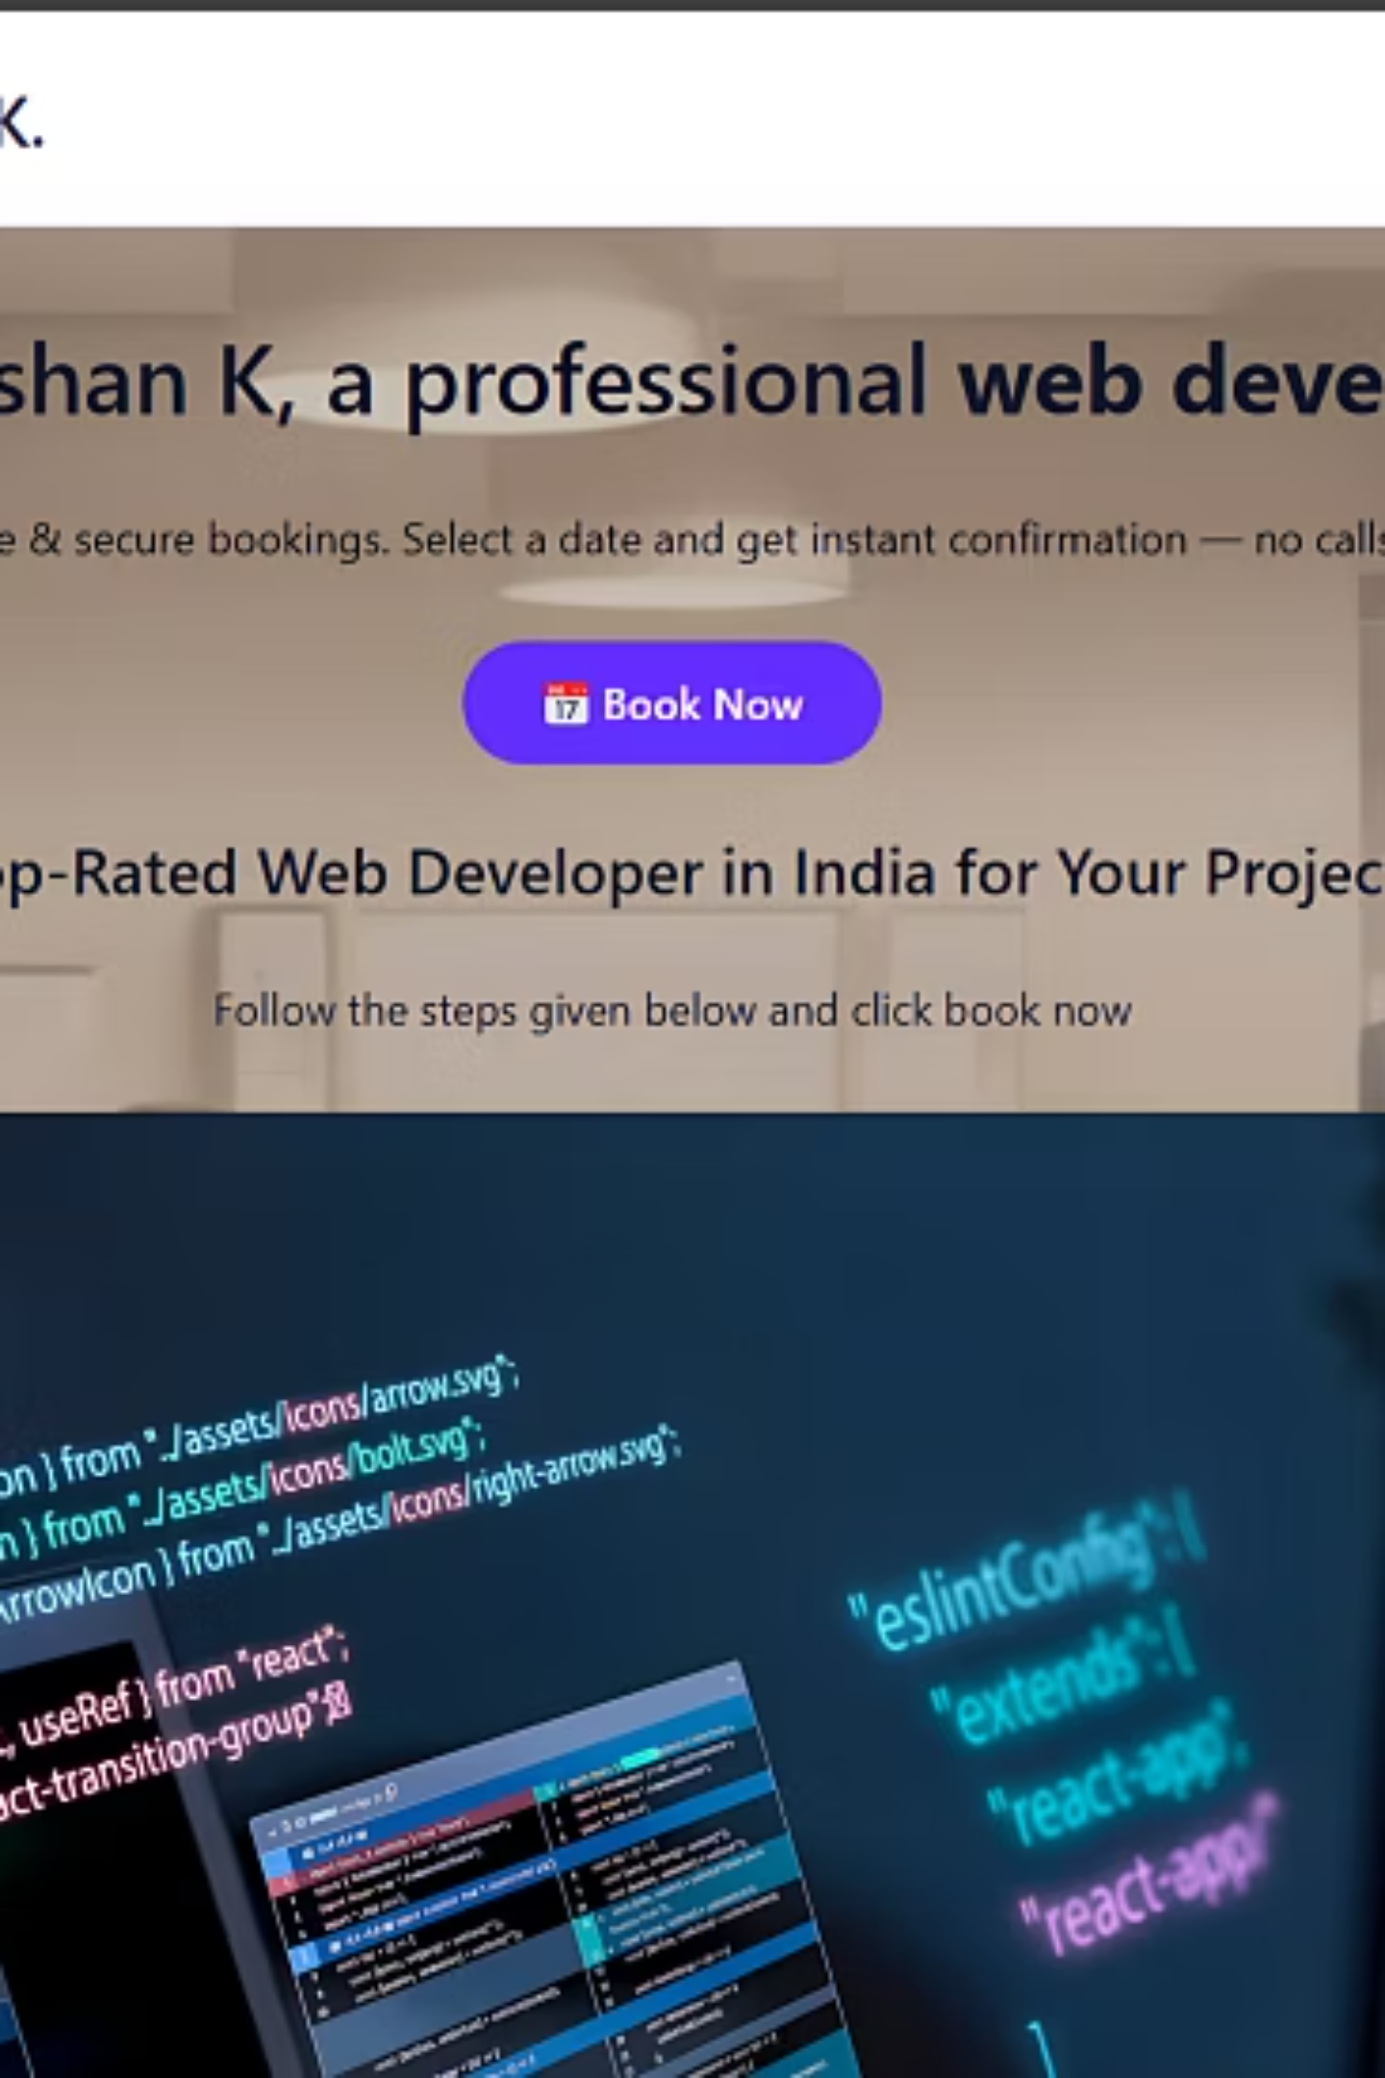
WordPress Website Project – Appointment Booking Platform
Developed for Web Developer Ishan K By: Ishan Kalhe

Slide 2
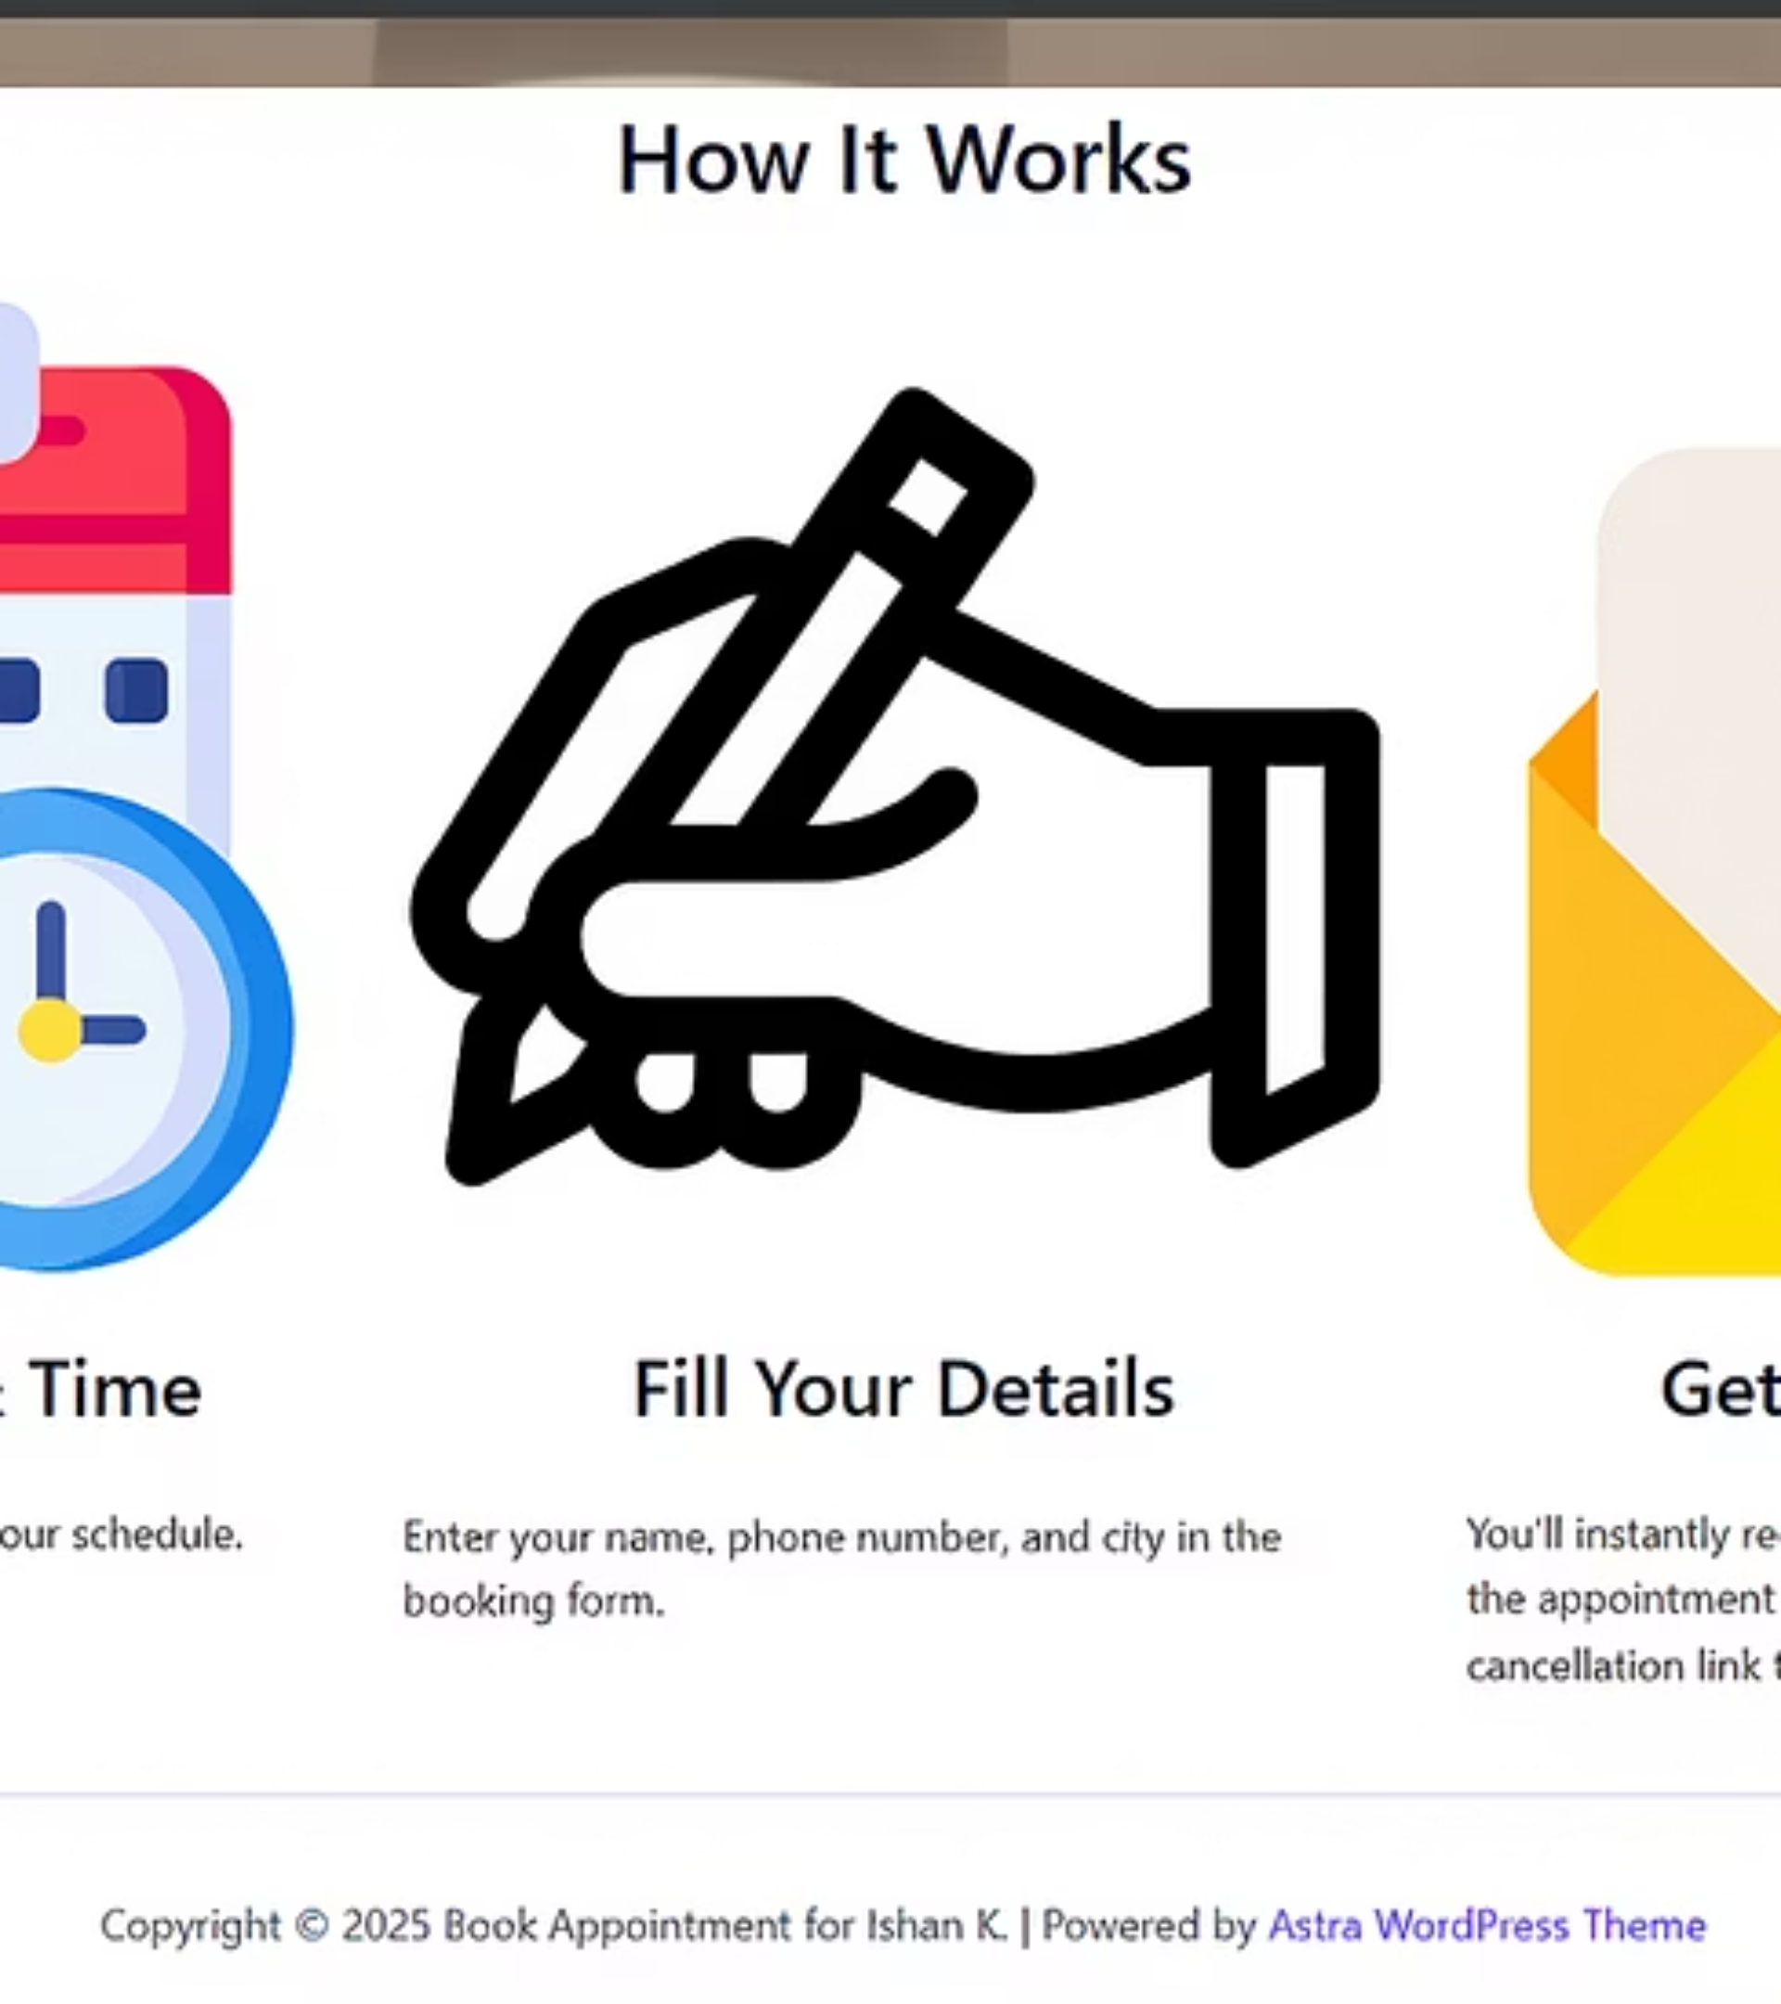
Project Overview: Streamlined Appointment Booking
This website was built as a professional appointment booking system for Ishan K, a web developer. The primary goal is to allow clients to easily schedule appointments online without back-and-forth messaging or calls. It offers a streamlined interface where users can pick a date and time, submit their details, and receive confirmation.

Slide 3
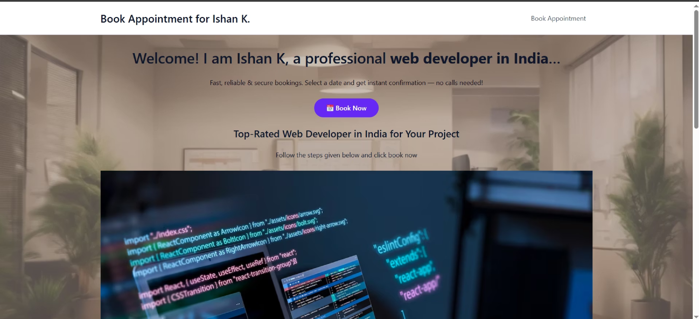
Homepage: First Impressions Matter
Clear Headline
Compelling Tagline
Call-to-Action
A prominent headline quickly communicates the site's purpose: booking a developer.
A concise tagline provides a basic description of Ishan K's services and expertise.
Strategically placed buttons guide users directly to the appointment booking page.

Slide 4
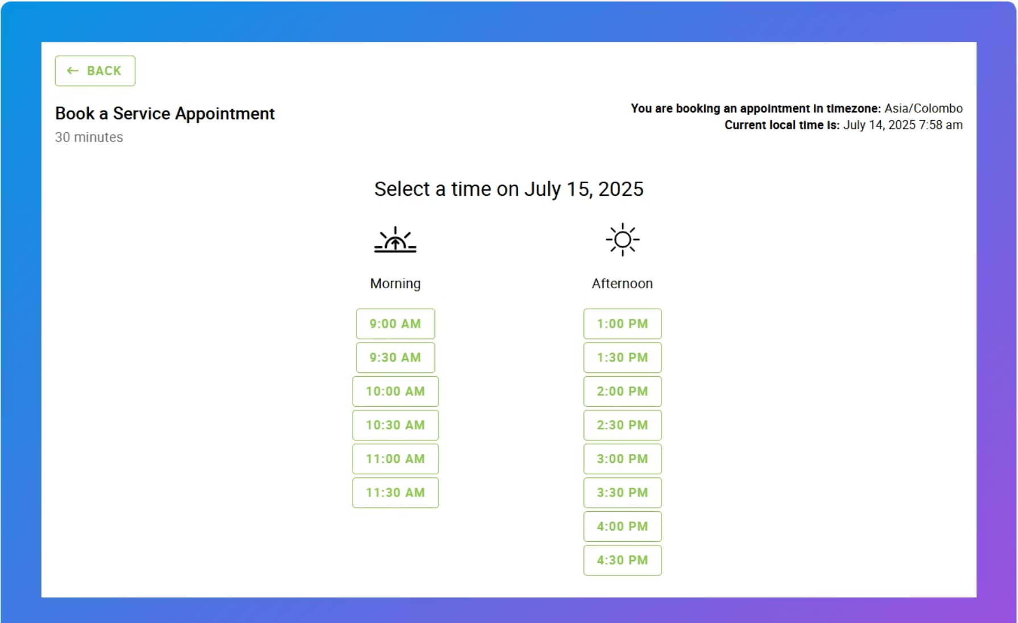
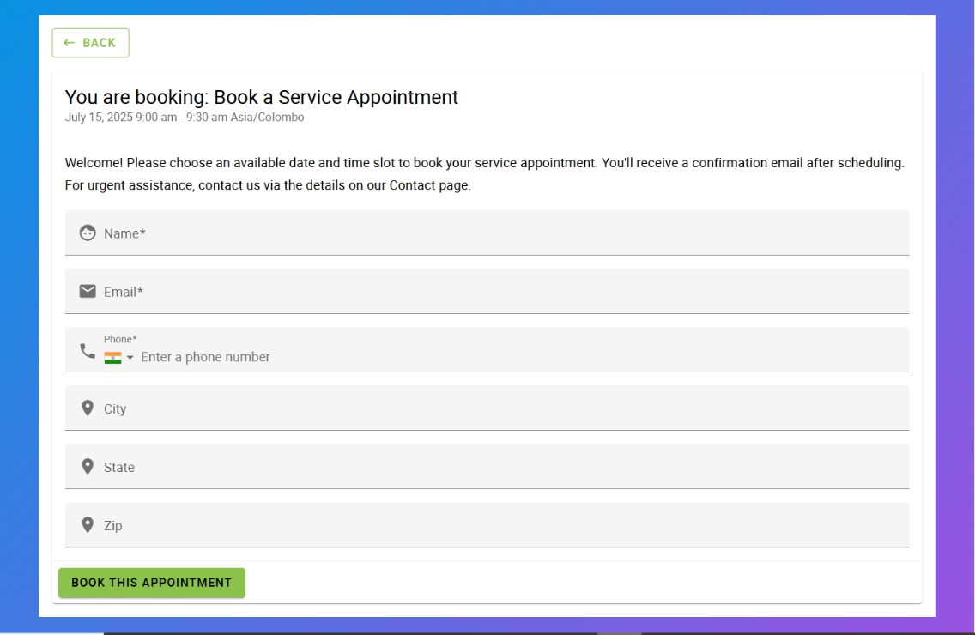
Appointment Booking Process
Submission Confirmation
Automated Notifications
A clear confirmation message is displayed post-submission, reassuring the user.
Enter Details
Instant email confirmations are sent to both the user and the administrator.
Select Date & Time
Fields for name, email, and service specifics ensure all necessary information is collected.
Clients choose their preferred slot from an intuitive calendar interface.

Slide 5






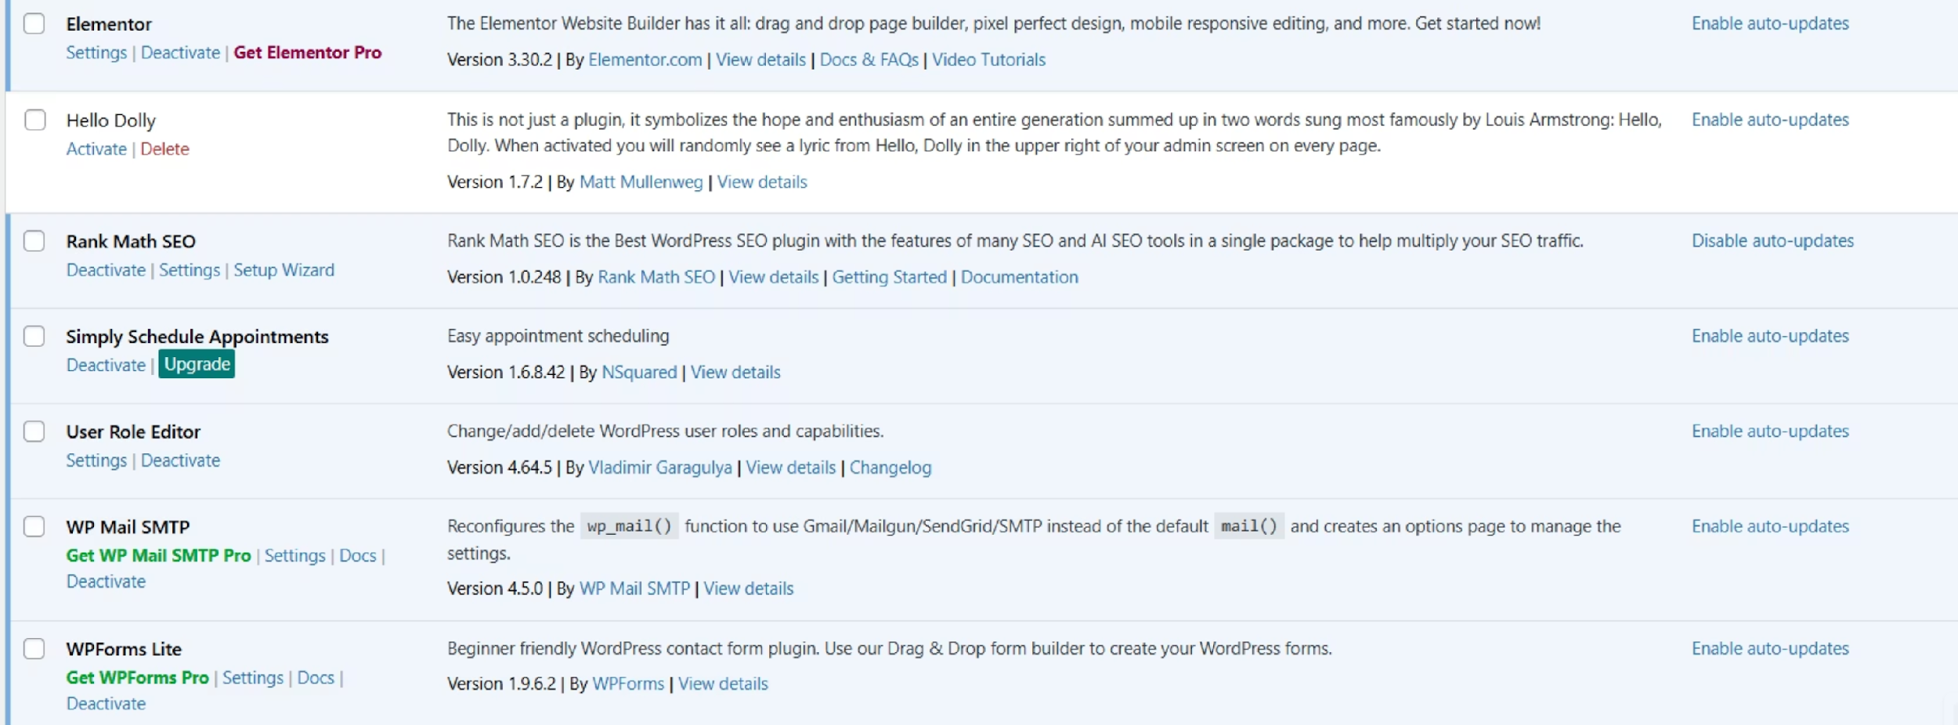
Key WordPress Plugins Utilized
These essential plugins power the website's functionality, from appointment scheduling and email delivery to form management, user permissions, SEO, and visual design.

Slide 6


Design & User Experience with Astra and Elementor
The website's design is built using the Astra theme, known for its performance and flexibility. It ensures a mobile-responsive layout that adapts seamlessly across all devices, from desktops to smartphones.
The user interface is clean and professional, prioritizing intuitive navigation. Special attention was given to the user flow, ensuring a quick and efficient path to the appointment booking functionality. All visual elements and layouts were meticulously crafted using Elementor, providing a drag-and-drop interface for precise design control.

Slide 7
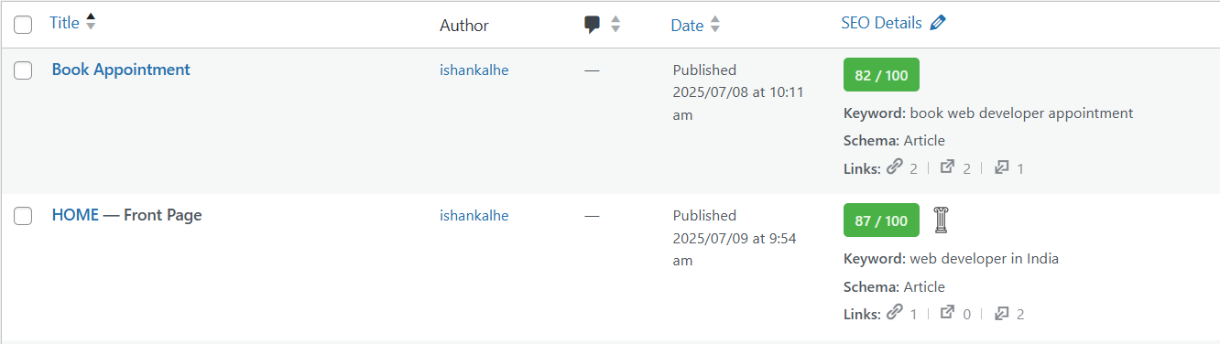
SEO Optimization with Rank Math
Search Engine Optimization (SEO) was a critical component of this project, primarily handled using Rank Math SEO. This ensures the website is easily discoverable by potential clients through search engines.
87%
82%
Home Page SEO Score
Appointment Page SEO Score
Reflects strong optimization for target keywords and content structure.
Ensures the core conversion page ranks well for booking-related queries.
Key optimization efforts included comprehensive meta descriptions, ensuring a fully responsive layout, and optimizing for fast loading times, all contributing to improved search engine performance and user experience.

Slide 8
Technical Challenges: WP Mail SMTP Configuration
One of the primary challenges encountered during development was the configuration of WP Mail SMTP, particularly when integrating with Google's services.
Setting up OAuth 2.0 for secure Gmail authentication required careful attention to Google API Console configurations and credentials management.
Verifying sender identity involved domain authentication processes to ensure emails were delivered reliably and not flagged as spam.
Integrating with Google Analytics for tracking form submissions posed complexities in ensuring accurate data flow from the booking forms to analytics reports, crucial for performance monitoring.

Slide 9

THANK YOU
Link of the website:- https://ishankwordpress.byethost7.com/
Link of full Report:- Report

